Slide 1

TeXT BOOK CLUSTERING
IV B.TECH 1 SEM ECE 1 BATCH A AY:2023-2024
Student Name: Ch.Bhargavi
20JG1A0419
Supervisor: M.Hemlata Assistant Professor, ECE Department
DEPARTMENT OF ELECTRONICS AND COMMUNICATION ENGINEERING (ECE)
GAYATRI VIDYA PARISHAD COLLEGE OF ENGINEERING FOR WOMEN
MADHURAWADA, VISAKHAPATNAM-530048

Slide 2

TOPICS
Introduction to Data Science
Data preparation
Exploratory Data Analysis
Machine Learning with Python
INTRODUCTION TO FLASK
Front end : html , css
Project
Conclusion

Slide 3
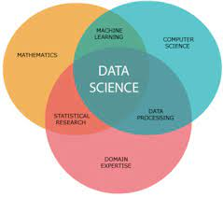
INTRODUCTION TO DATA SCIENCE
Data science is a field that involves using statistical and computational techniques to extract insights and knowledge from data.
It encompasses a wide range of tasks, including data cleaning and preparation, data visualization, statistical modeling, machine learning, and more.
Data scientists use these techniques to discover patterns and trends in data, make predictions, and support decision-making.
They may work with a variety of data types, including structured data (such as numbers and dates in a spreadsheet) and unstructured data (such as text, images, or audio).
Data science is used in a wide range of industries, including finance, healthcare, retail, and more.

Slide 4
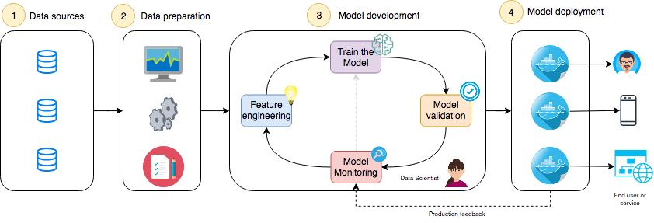
DATA PREPARATION
Feature Engineering :
Feature engineering is the process of creating new features or transforming existing features to improve the performance of a machine-learning model. It involves selecting relevant information from raw data and transforming it into a format that can be easily understood by a model. The goal is to improve model accuracy by providing more meaningful and relevant information.

Slide 5
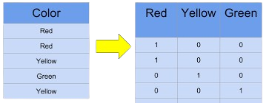
Data transformation:
Data transformation is the process of converting raw data into a More appropriate format or structure for analysis, interpretation, or presentation. It involves various operations aimed at preparing data for further processing, visualization, or Modeling.
One- Hot Encoding:
One-hot encoding is a technique used to transform categorical variables into numerical values that can be used by machine learning models. In this technique, each category is transformed into a binary value indicating its presence or absence. For example, consider a categorical variable “colour” with three categories: red, green, and blue. One-hot encoding would transform this variable into three binary variables: colour_red, colour_green, and colour_blue, where the value of each variable would be 1 if the corresponding category is present and 0 otherwise.

Slide 6
EXPLORATORY DATA ANALYSIS
Exploratory data analysis (EDA) refers to the method of studying and exploring record sets to discover patterns, locate outliers, and identify relationships between variables. EDA is normally carried out as a preliminary step before undertaking extra formal statistical analyses or modeling.
Goals of EDA:
1.)Descriptive statistics: EDA utilizes precise records to recognize the important tendency, variability, and distribution of variables. Measures like suggest, median, mode, preferred deviation, range, and percentiles are usually used.
2.)Correlation and relationships: EDA allows discover relationships and dependencies between variables. Techniques such as correlation analysis, scatter plots, and pass-tabulations offer insights into the power and direction of relationships between variables.

Slide 7
3.)Data visualization: EDA employs visual techniques to represent the statistics graphically. Visualizations consisting of histograms, box plots, scatter plots, line plots, heatmaps, and bar charts assist in identifying styles, trends, and relationships within the facts.
Types of EDA:
1.) Univariate analysis: It involves summarizing and visualizing a single variable at a time to understand its distribution and relevant tendency. Techniques like histograms, box plots, bar charts, and pie charts information are generally used in univariate analysis.
2.) Bivariate analysis: Bivariate evaluation involves exploring the correlation between variables. Scatter plots, line plots and correlation matrices are generally used strategies in bivariate analysis.
3.) Multivariate analysis: It involves exploring the interactions and dependencies among more than one variable in a record set. Techniques like heatmaps are used in multivariate analysis

Slide 8
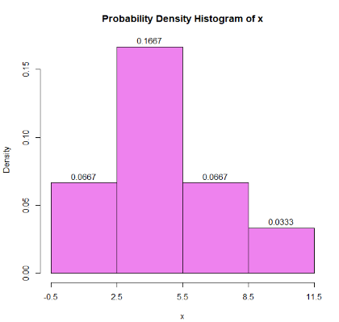
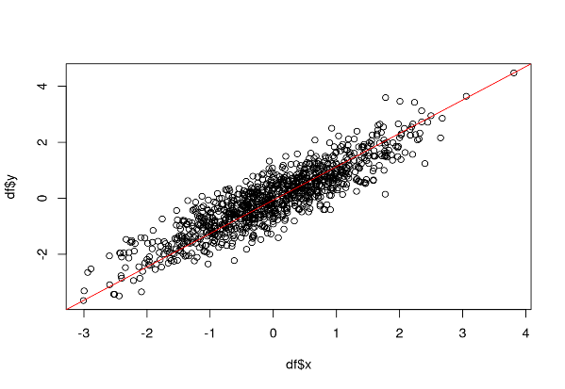
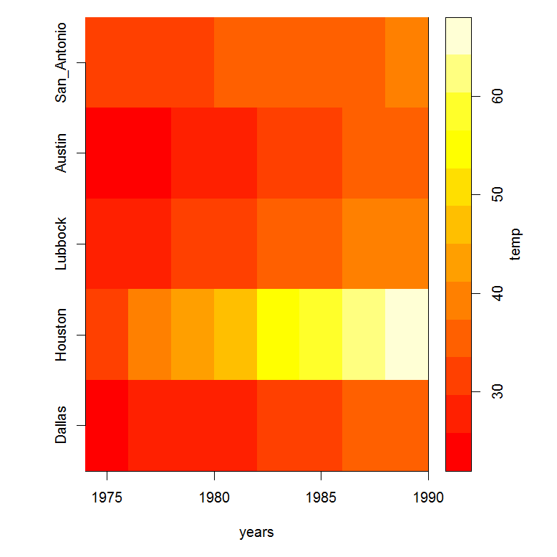
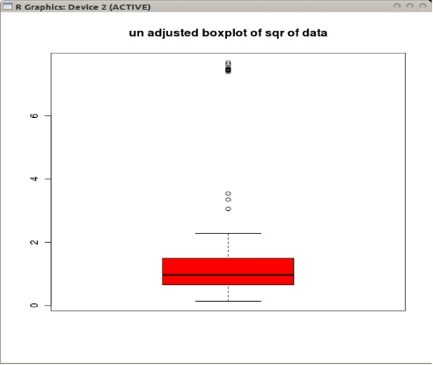
4.) Outlier analysis: Outliers are statistics factors that drastically deviate from the general sample of the facts. Outlier analysis includes identifying and knowledge the presence of outliers, their capability reasons, and their impact at the analysis. Techniques along with box plots, scatter plots, z-rankings, and clustering algorithms are used for outlier evaluation.
Fig: Histogram plot
Fig: Scatter plot
Fig: Heat map
Fig: Outliers in box plot

Slide 9
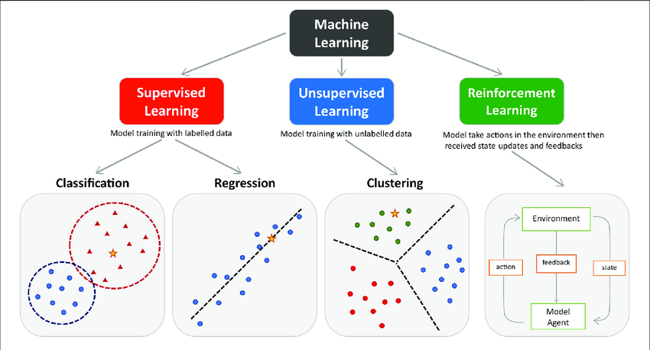
MACHINE LEARNING WITH PYTHON
Machine learning algorithms are computational techniques that enable systems to learn and improve from experience without being explicitly programmed. These algorithms use data to recognize patterns, make predictions or optimize outcomes.
We have three main categories of machine learning. They are supervised learning, unsupervised learning and reinforcement learning.

Slide 10

INTRODUCTION TO FLASK
Flask is a lightweight and versatile web framework for python used to build web applications. It's known for its simplicity and flexibility, making it a popular choice among developers for creating web services, apis, and even complex web apps. Flask provides tools, libraries, and patterns that allow developers to build web applications quickly and efficiently. It's known for its minimalistic design, giving developers the freedom to choose the components they need for their projects and keeping the core simple and easy to understand.

Slide 11

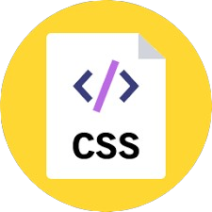
FRONT END
HTML:
HTML stands for hypertext markup language. It's the standard markup language used to create web pages. It's the backbone of every webpage on the internet, defining the structure and content of a web page by using various tags and elements. These elements include headings, paragraphs, links, images, tables, forms, and more.
CSS:
CSS stands for cascading style sheets.CSS describes how HTML elements are to be displayed on screen, paper, or in other media.CSS saves a lot of work. It can control the layout of multiple web pages all at once.External stylesheets are stored in CSS files

Slide 12


PROJECT: Text Book Clustering
OBJECTIVE:
The objective of the project is to develop a website that can automatically organize and categorize textbooks based on their content, topics, or subject areas.
Tools: libraries :
● pandas, numpy, matplotlib : basic data transformation and visualization
● pypdf2 : text extraction
● dataprep : text cleaning
● nltk : text processing and analysis
● gensim : model development
Framework : flask - flexible way to develop webpage.
Frontend : html, css.

Slide 13
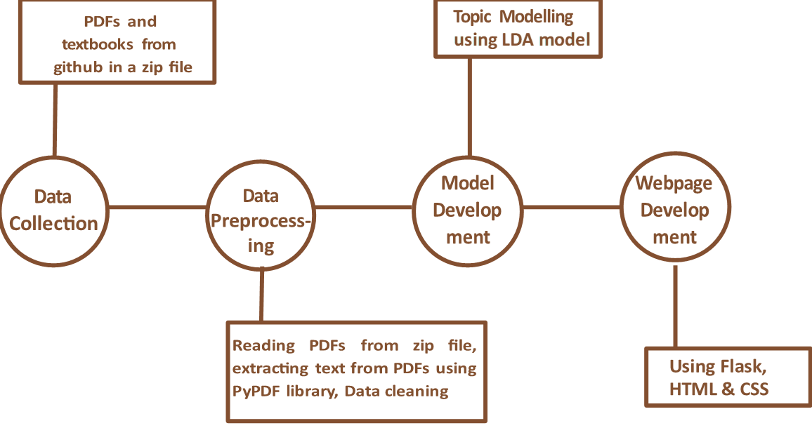
Analytical approach:
The data had textbook pdfs of different subject downloaded from github, and our own textbooks. It can observe that the topics vary a lot ranging from data science to electrical systems

Slide 14
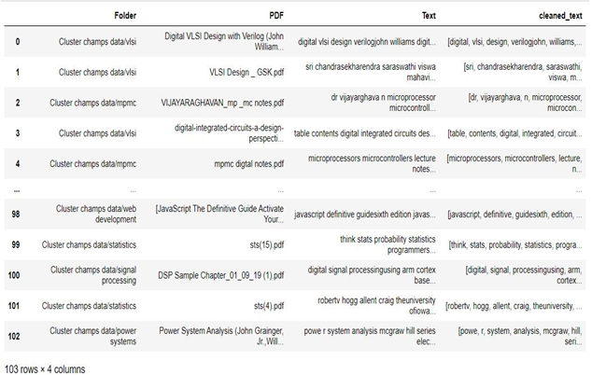
Data collection: Around 103 PDF files are collected from github and other websites sources : github, mrcet.Com.
Data preprocessing: The first 25 pages text is extracted from pdfs using pypdf2 library - basic data cleaning like removing digits, removing urls, lowercase the text is done using dataprep library - stop-words are removed and a corpus is build which is later converted into “bag of words” (bow)

Slide 15
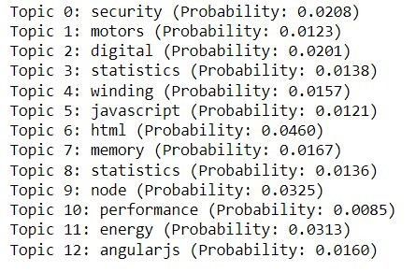
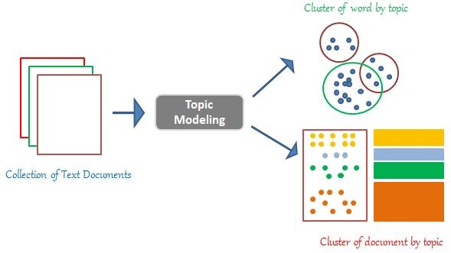
Model Development:
Topic modelling approach is used to group textbooks with similar topics together. The latent dirichlet allocation (LDA) is trained on the corpus to extract topics of the documents. LDA assumes that each document is generated by a statistical generative process. That is, each document is a mix of topics, and each topic is a mix of words.

Slide 16
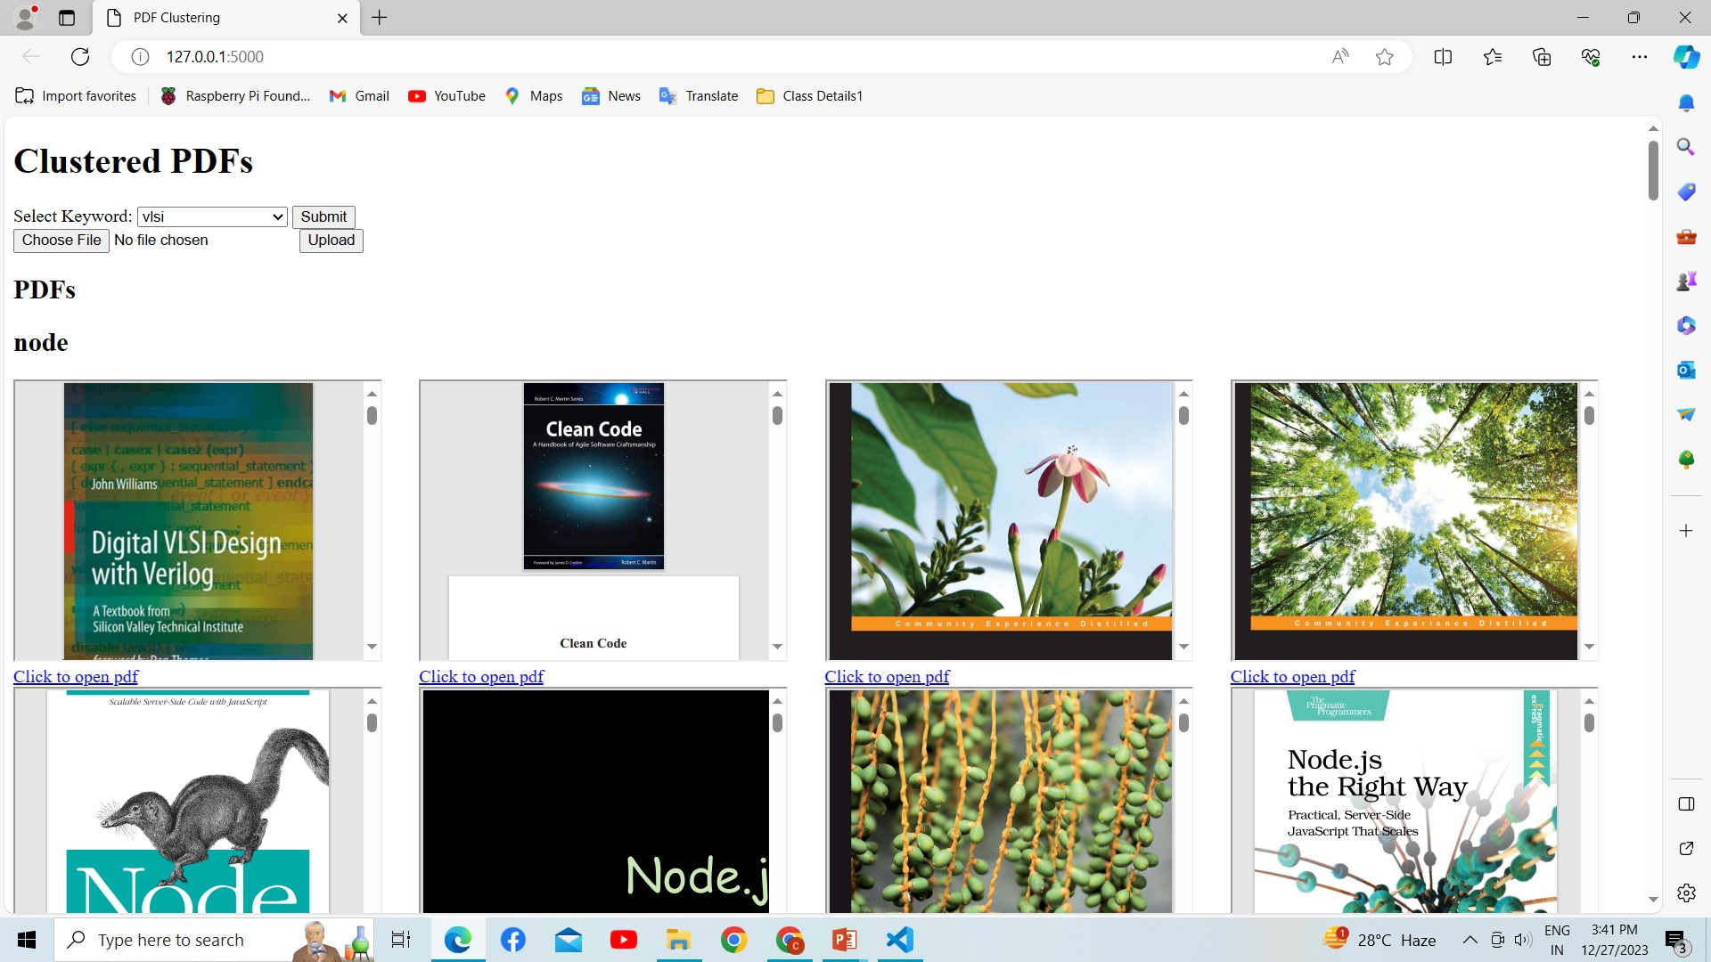
Web page

Slide 17
CONCLUSION:
In conclusion, this project successfully demonstrated the integration of data science techniques and web development to create a powerful platform for exploring and understanding diverse books. The clustering algorithm and LDA model contribute to a nuanced categorization, while the web interface ensures a user-friendly experience.
By combining technical expertise and creative design, we have created a valuable tool for book enthusiasts and researchers alike, showcasing the potential of interdisciplinary projects in the realm of information technology.

Slide 18
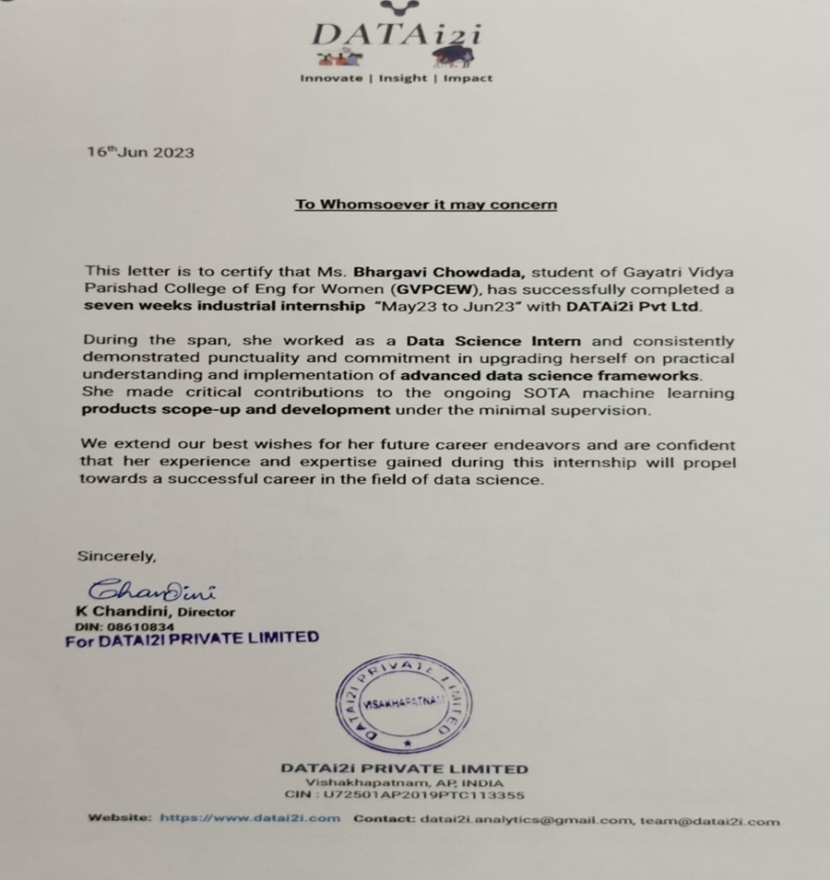

Slide 19
THANK YOU

